Slide 1
THE THIRD EYE GLOVE
An Arduino-Based Smart Obstacle Detection System
‘A Project for visually impaired community’

Slide 2
INTRODUCTION
Visually impaired people face difficulty detecting nearby obstacles
Traditional walking sticks have limited range and accuracy
Technology can assist by providing real-time obstacle alerts
The Third Eye Glove is a wearable, low-cost smart solution

Slide 3
What is it, actually?
Makes Me Aware
It helps visually impaired users understand the space around them without having to touch anything.
Finds Stuff
It uses these tiny ultrasonic sensors (like a bat!) to find objects that are nearby.
Gives a Buzz
It immediately changes the distance information into a vibration signal you can feel easily.
More Freedom
The main point is to help people walk around more safely, confidently, and all by themselves!

Slide 4
Problem Statement
Lack of awareness about obstacles in front of visually impaired people
Risk of accidents due to sudden obstacles
Existing solutions are costly or inconvenient
Need for a portable, affordable, and easy-to-use device

Slide 5
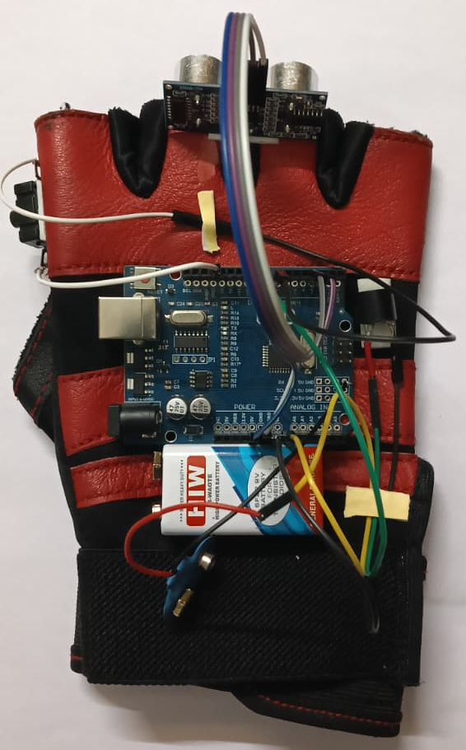
The Cool Design
• Sensors are Smartly Placed: They are put on the glove in the best spots to see as much as possible.
• Finger Signals: The vibrations happen on specific fingers, so you know exactly where the object is.
• Distance is Clear: The buzz level clearly tells you: “Danger, it’s right here!” or “Relax, you have space.”
• Fits Great: It’s shaped nicely to fit the hand, which makes it easy and comfortable to use.

Slide 6
Objective of the Project
To design a smart wearable glove for obstacle detection
To detect obstacles using ultrasonic sensing
To alert the user through sound/light signals
To improve safety and independence of visually impaired users

Slide 7
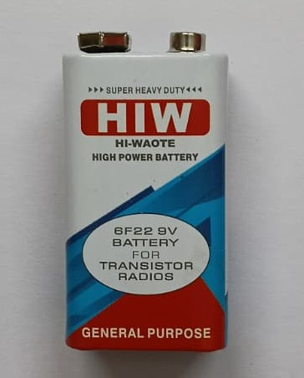
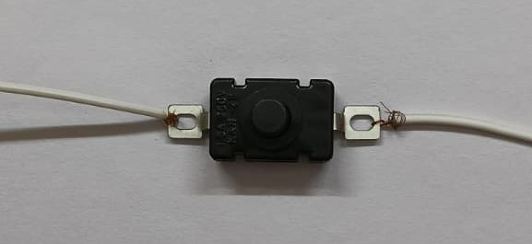
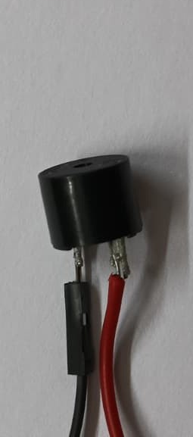
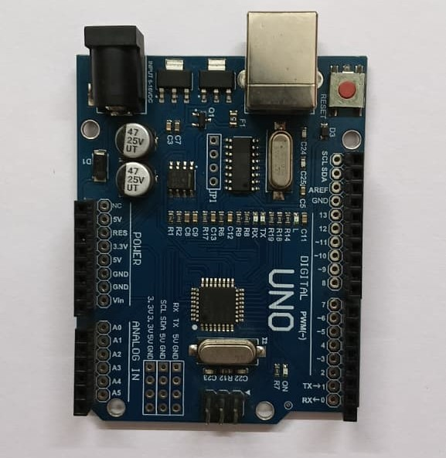
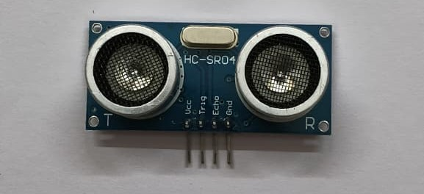
Hardware Components Used
Arduino UNO
HC-SR04 Ultrasonic Sensor
Buzzer
LED
9V Battery / Power Supply
Switch
Connecting Wires
Glove (wearable base

Slide 8
Software & Tools
Arduino IDE (for coding)
Embedded C / Arduino Programming
Proteus (for simulation – optional)
USB Cable for programming Arduino

Slide 9
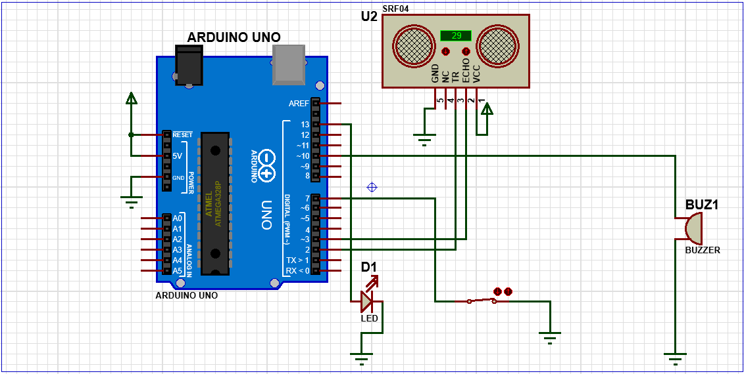
Block Diagram
Blocks:
Power Supply
Ultrasonic Sensor
Arduino UNO
Output Devices (Buzzer & LED)

Slide 10
Working Principle
Ultrasonic sensor emits sound waves
Sound waves hit an obstacle and reflect back
Arduino calculates distance using time delay
If obstacle is within a set range:
.Buzzer alerts the user
.LED indicates proximity

Slide 11
How the Tech Works
• It's Always Scanning: The sensors are always sending out sound waves to check the area in front of the user.
• Buzz Tells Distance: If something is close, it buzzes harder. If it's far, it buzzes softly or not at all.
• Super Fast Warning: It gives a real-time warning right on your hand—it's like an instant safety shield!
• Easy to Wear: We designed it to be light and comfy so you can wear it all day without trouble.

Slide 12
Algorithm
Start the system
Trigger ultrasonic sensor
Measure echo time
Calculate distance
If distance < threshold:
Turn ON buzzer
Turn ON LED
Else:
Keep outputs OFF
Repeat continuously

Slide 13
Advantages
Low cost and portable
Easy to use
Real-time obstacle detection
Wearable and hands-free
Improves user safety

Slide 14
How It Helps People
• Better Than the Cane: It’s a modern upgrade—you can sense things without just poking around with a cane.
• Simple Feelings: It takes complicated electronic data and turns it into simple, easy-to-understand feelings on your hand.
• Walk with Confidence: This really helps people move, find their way, and feel much more confident about being out alone.
• Stops Accidents: It’s a constant safety net that drastically lowers the chance of bumping into things or falling.

Slide 15
Future Enhancements
Add vibration motor for silent alerts
Use GPS for navigation assistance
Voice guidance using speaker module
AI-based object recognition
Mobile app integration

Slide 16
What I Want to Add Next!
Built-in GPS
I want to add outdoor tracking to help guide users to specific places.
Voice Helper
Maybe replace the buzzes with a voice telling them. things like "Stop" or "Tum Left
Al Camera
Using a small camera and Al to recognize money. faces, or stop signs!
A Panic Button
A feature that could send an emergency text to family if the user falls.

Slide 17
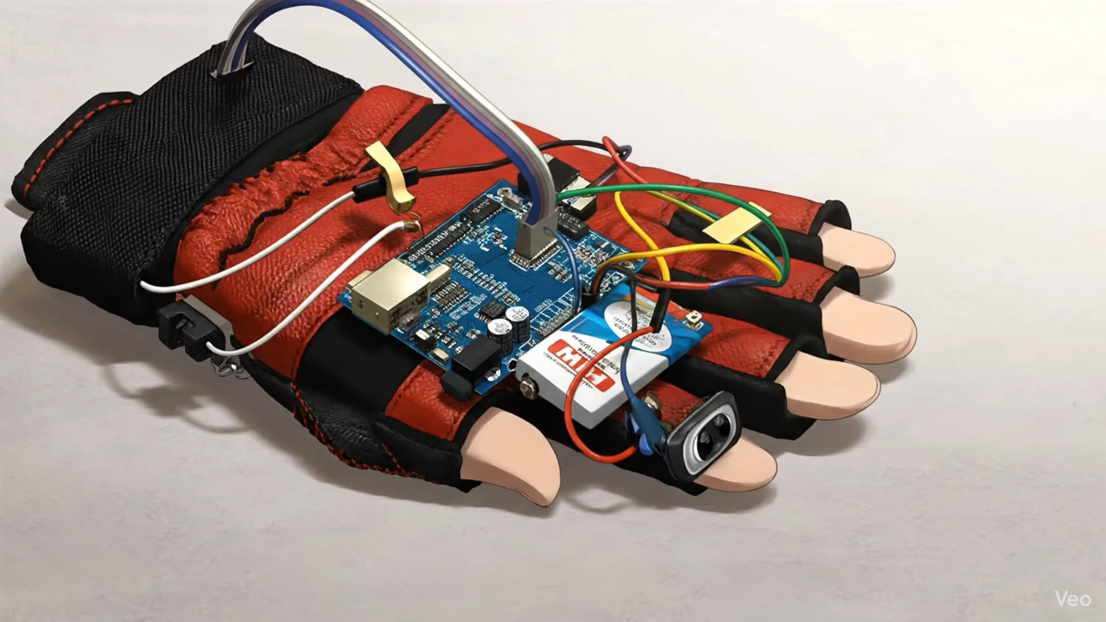
Why I Call It the ‘Third Eye’
• Tech Combo: It smartly mixes the finding technology (ultrasound) with the feeling technology (vibration).
• An Extra Sense: It gives the user an extra, artificial sense that they wouldn’t normally have.
• Sees Farther: It helps you know about objects that are beyond your reach—things you can’t hear or touch yet.
• Real Freedom: This ability to “see” beyond your hands is why it’s so important for safe, independent living.

Slide 18
Real-World Uses
Every Single Day
It’s great for everything—from walking in the hallway at home to crossing a busy sidewalk.
Works Anywhere
It keeps you safe in different places, both inside buildings and outside on the street.
Less Help Needed
It really reduces how much the user needs to rely on other people for directions.
Self-Esteem
It directly helps people feel better about themselves and their ability to be autonomous.

Slide 19
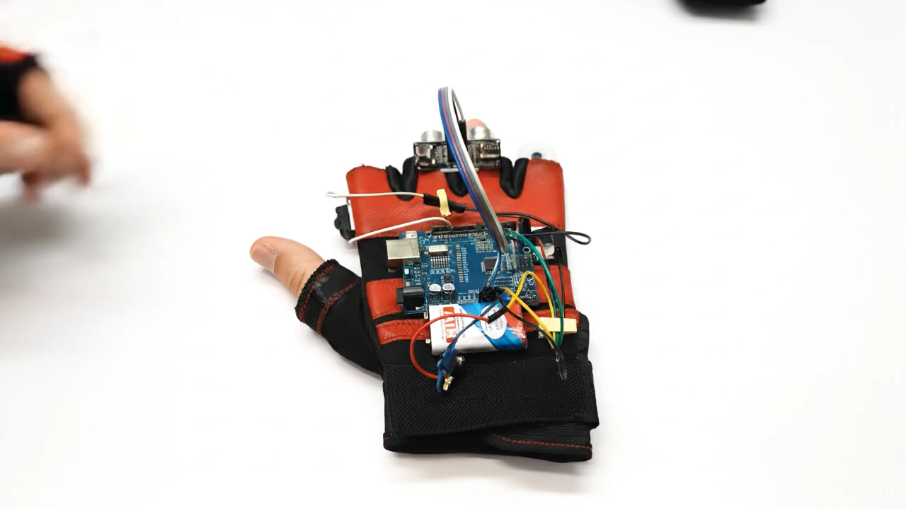
Focus: Getting Around
Instant Response
It finds and signals obstacles instantly—no waiting time at all.
Buzzing Maps
It tells you distance using patterns you can easily learn and remember.
Crowd Handler
It helps users move confidently even in crowded or tricky places like narrow doorways.
The Main Goal
Designed to help people move and travel completely on their own.

Slide 20
What's Inside? The Parts
The Brain (Arduino): This little computer chip takes all the data and makes all the decisions.
The Eyes (Ultrasonic Sensor): It's the part that sends out sound waves to 'see' obstacles.
The Sense (Buzzer): The buzzer is what buzzes to let the user know if they need to stop.
The Power (Battery): A small battery that makes sure the glove keeps running wirelessly.

Slide 21
How They Talk (The Circuit)
Simple Chat: The sensor constantly tells the Arduino board how far away objects are.
Decision Time: If the object is too close (uh oh, danger!), the Arduino sends a signal to start the motor.
Smart Pins: One pin sends the signal out ("Trigger"), and the other listens for the sound to bounce back ("Echo")

Slide 22
Wrapping Up
Freedom is Key
This glove isn't just tech; it's about giving people dignity and freedom to explore.
Simple and Cheap
By keeping the technology basic, we can make it affordable and available to everyone who needs it.
New Way to Sense
We're fixing the missing sense of sight by boosting the sense of touch.
My Dream
To help create a world where not being able to see doesn't stop anyone from doing what they want!

Slide 23
Conclusion
The Third Eye Glove is an effective assistive device
Provides safety and independence to visually impaired users
Simple, affordable, and reliable solution
Demonstrates practical application of Arduino and sensors

Slide 24
THANK YOU

